Slide 1
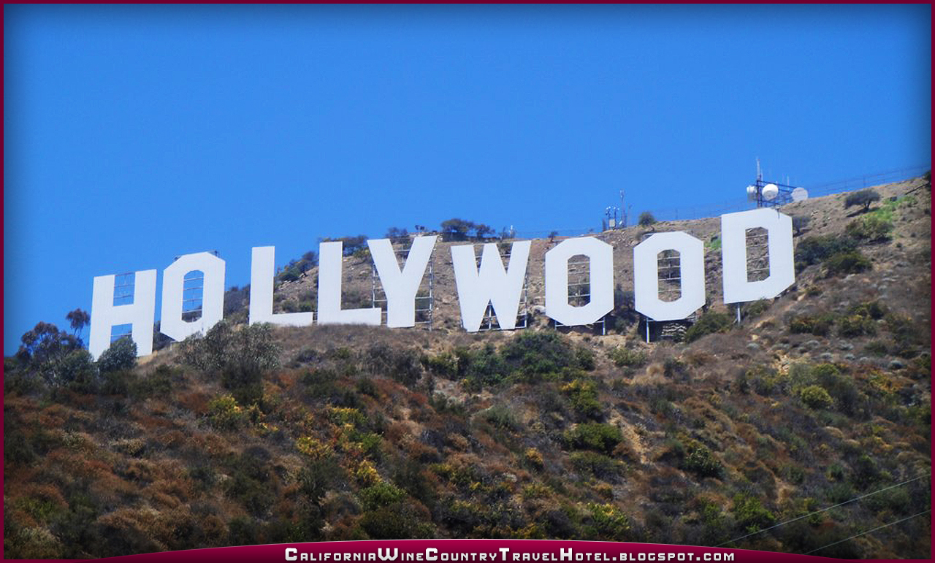
My California trip
By: will nissley

Slide 2
San Diego
I had lots of fun in San Diego! I went to the San Diego Zoo and I saw bears, a brown striped zebra, birds, flamingos, and deer. I also went to La Jolla Cove and saw sea lions resting on the beach. Also a man jumped off a cliff into the ocean. We also drove out to Coronado Island and ate at a place called In and Out Burger.

Slide 3
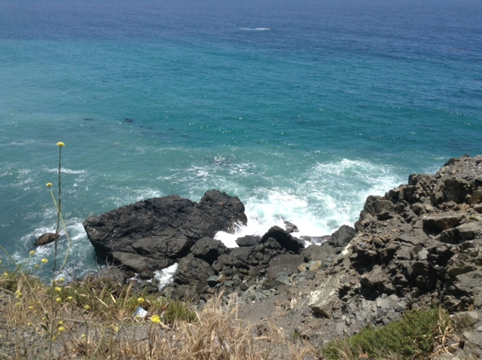
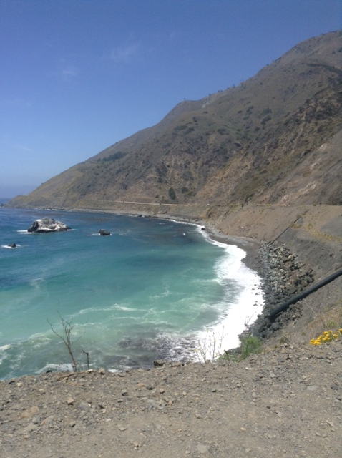
San Diego Pictures

Slide 4
Hearst Castle
William Randolph Hearst (/hɜrst/;^{[1]} April 29, 1863 – August 14, 1951) was an American newspaper publisher who built the nation's largest newspaper chain and whose methods profoundly influenced American journalism.^{[2]} Hearst entered the publishing business in 1887 after taking control of The San Francisco Examiner from his father. Moving to New York City, he acquired The New York Journal and engaged in a bitter circulation war with Joseph Pulitzer's New York World that led to the creation of yellow journalism—sensationalized stories of dubious veracity. Acquiring more newspapers, Hearst created a chain that numbered nearly 30 papers in major American cities at its peak. He later expanded to magazines, creating the largest newspaper and magazine business in the world.
He was twice elected as a Democrat to the U.S. House of Representatives, and ran unsuccessfully for Mayor of New York City in 1905 and 1909, for Governor of New York in 1906, and for Lieutenant Governor of New York in 1910. Nonetheless, through his newspapers and magazines, he exercised enormous political influence, and was famously blamed for pushing public opinion with his yellow journalism type of reporting leading the United States into a war with Spain in 1898.
His life story was the main inspiration for the development of the lead character in Orson Welles's film Citizen Kane.^{[3]} His mansion, Hearst Castle, on a hill overlooking the Pacific Ocean near San Simeon, California, halfway between Los Angeles and San Francisco, was donated by the Hearst Corporation to the state of California in 1957, and is now a State Historical Monument and a National Historic Landmark, open for public tours. Hearst formally named the estate La Cuesta Encantada("The Enchanted Hill"), though he typically referred to it simply as "the ranch."

Slide 5
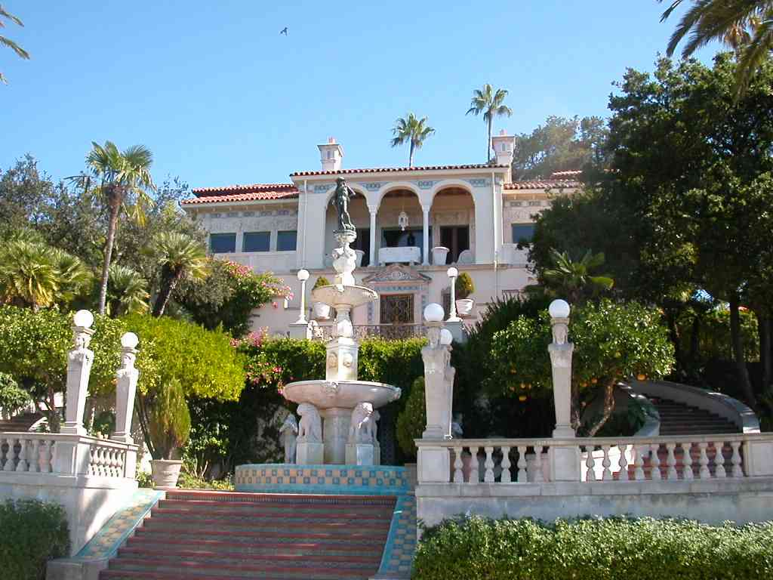
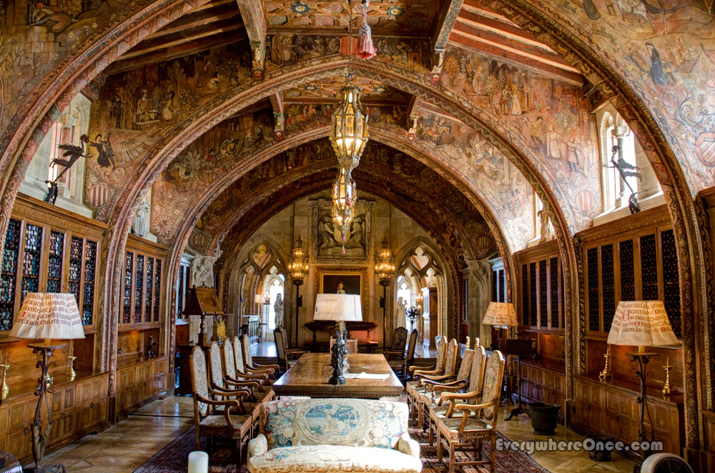
Hearst Castle Pictures

Slide 6
Los Angeles
City of Los Angeles and often known by its initials L.A., is the second-largest city in the United States, the most populous city in the U.S. state of California, and the county seat of Los Angeles County. Situated in Southern California, Los Angeles is known for its mediterranean climate, ethnic diversity, sprawling metropolis, and as a major center of the American entertainment industry. Los Angeles lies in a large coastal basin surrounded on three sides by mountains reaching up to and over 10,000 feet (3,000 m).
Historically home to the Chumash and Tongva, Los Angeles was claimed by Juan Rodríguez Cabrillo for Spain in 1542 along with the rest of what would become Alta California. The city was officially founded on September 4, 1781, by Spanish governor Felipe de Neve. It became a part of Mexico in 1821 following the Mexican War of Independence. In 1848, at the end of the Mexican–American War, Los Angeles and the rest of California were purchased as part of the Treaty of Guadalupe Hidalgo, thereby becoming part of the United States. Los Angeles was incorporated as a municipality on April 4, 1850, five months before California achieved statehood.
The city is the focal point of the larger Los Angeles metropolitan area and the Greater Los Angeles Area region, which contains 13 million^{[15]} and over 18 million people, respectively, as of 2010, making it one of the most populous metropolitan areas in the world as well as the second-largest in the United States. Los Angeles is the seat of Los Angeles County, the most populated county in the United States. The city's inhabitants are referred to as Angelenos.
Nicknamed the City of Angels, Los Angeles is a global city with a diverse economy in entertainment, culture, media, fashion, science, sports, technology, education, medicine and research. It has been ranked sixth in the Global Cities Indexand 9th Global Economic Power Index. The city is home to renowned institutions covering a broad range of professional and cultural fields and is one of the most substantial economic engines within the United States. The Los Angeles combined statistical area (CSA) has a gross metropolitan product (GMP) of $831 billion (as of 2008), making it the third-largest in the world, after the Greater Tokyo and New York metropolitan areas. Los Angeles includes Hollywood and leads the world in the creation of television productions, video games, and recorded music; it is also one of the leaders in motion picture production. Additionally, Los Angeles hosted the Summer Olympic Games in 1932, 1984, and is currently bidding for the2024 Summer Olympics.

Slide 7
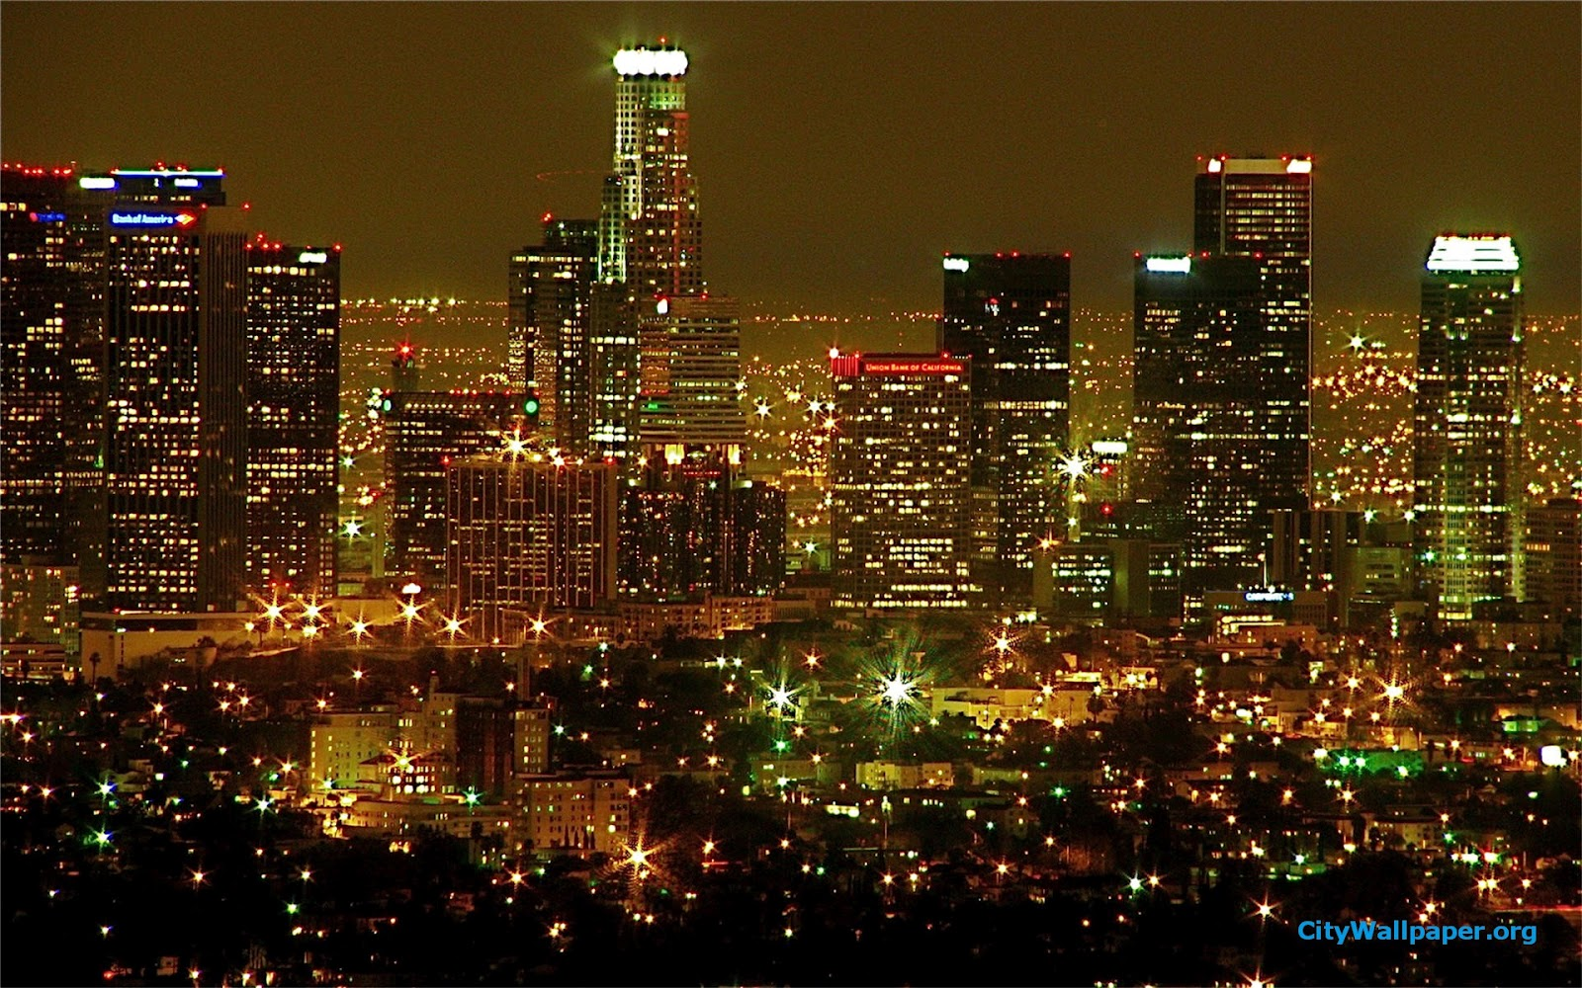
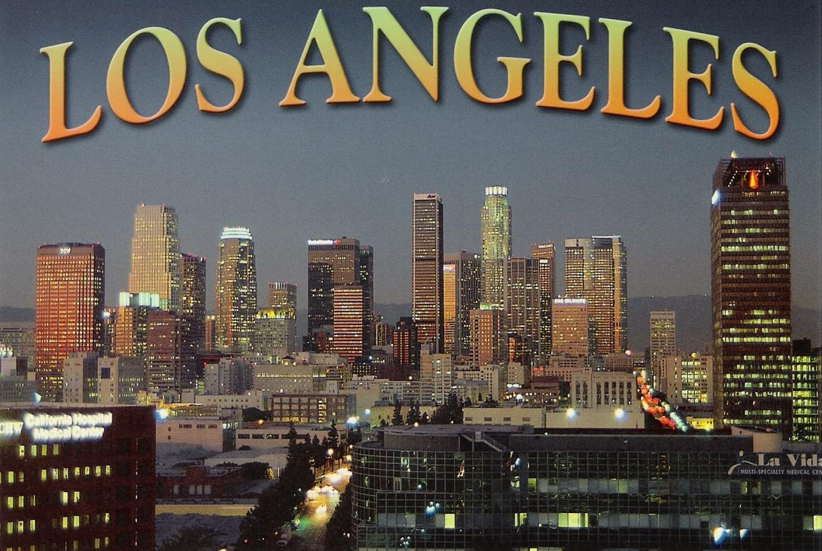
Los Angeles pictures

Slide 8
Thanks for watching,
Will Nissley

